Slide 1
Revision for the fraction test
Quick write - What have we learned to do with fractions?
Share your thoughts with your neighbour and then be prepared to share.
Notes:
James Wilson

Slide 2
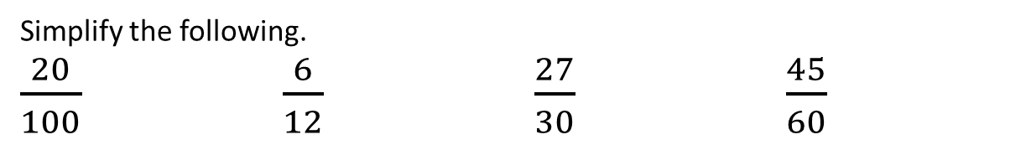
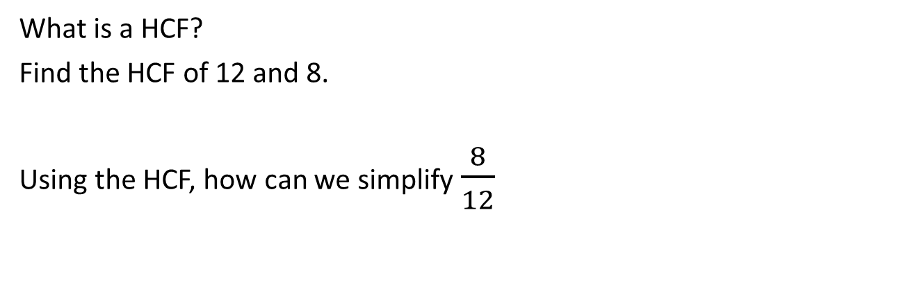
Simplifying fractions and equivalent fractions
What is a HCF?
Find the HCF of 12 and 8.
Using the HCF, how can we simplify $\frac{8}{12}$
Simplify the following.
$\frac{20}{100}$ $\frac{6}{12}$ $\frac{27}{30}$ $\frac{45}{60}$

Slide 3
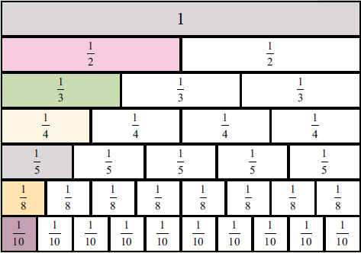


Compare Fractions
Which fraction is larger? $\frac{4}{5}$ or $\frac{7}{10}$
N$ow try these$
$\frac{3}{4}$ or $\frac{5}{8}$
$\frac{3}{4}$ or $\frac{9}{10}$
$\frac{1}{4}$ or $\frac{2}{8}$

Slide 4

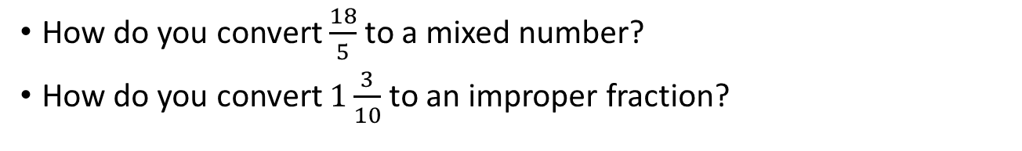
Mixed to Improper Fractions
How do you convert $\frac{18}{5}$ to a mixed number?
How do you convert $1\frac{3}{10}$ to an improper fraction?
Convert the following
1 $\frac{7}{10}$ 4 $\frac{4}{7}$
$\frac{24}{9}$ $\frac{71}{10}$

Slide 5

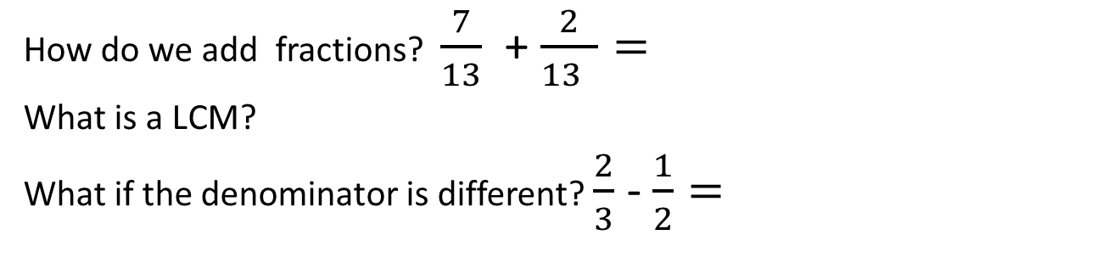
Adding and subtracting Fractions
How do we add fractions? $\frac{7}{13}$ + $\frac{2}{13 }=$
What is a LCM?
What if the denominator is different? $\frac{2}{3}$ - $\frac{1}{2}=$
Add or subtract the following.
$\frac{4}{5}$ + $\frac{1}{10 }$ $\frac{2}{7}$ - $\frac{1}{14 }$
$\frac{3}{4}$ + $\frac{2}{5 }$ $\frac{9}{12}$ - $\frac{3}{8 }$

Slide 6
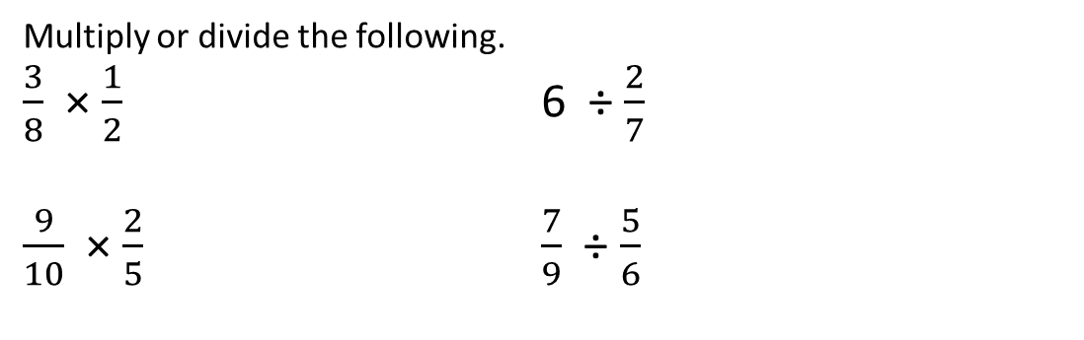
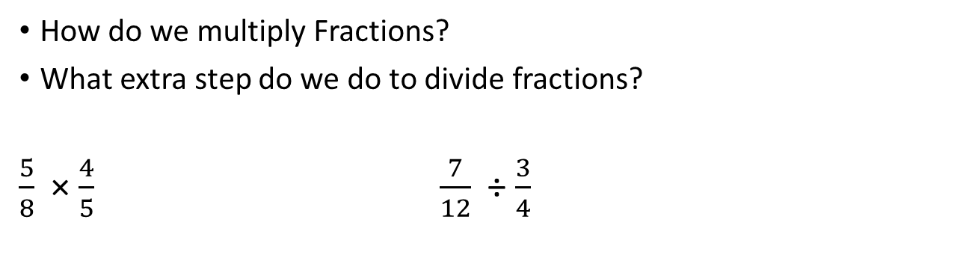
Multiply and Divide Fractions
How do we multiply Fractions?
What extra step do we do to divide fractions?
$\frac{5}{8}$ × $\frac{4}{5}$ $\frac{7}{12}$ ÷ $\frac{3}{4}$
Multiply or divide the following.
$\frac{3}{8}$ × $\frac{1}{2}$ 6 ÷ $\frac{2}{7}$
$\frac{9}{10}$ × $\frac{2}{5}$ $\frac{7}{9}$ ÷ $\frac{5}{6}$

Slide 7
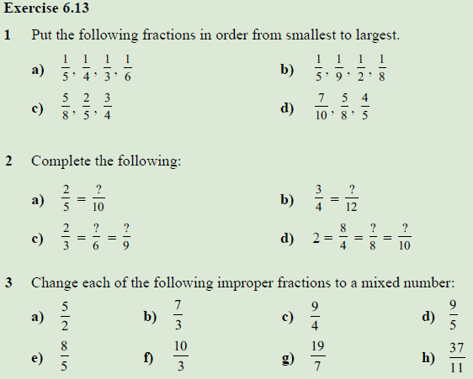
Now lets try the chapter review. (Page 85 – ex 6.13)

Slide 8
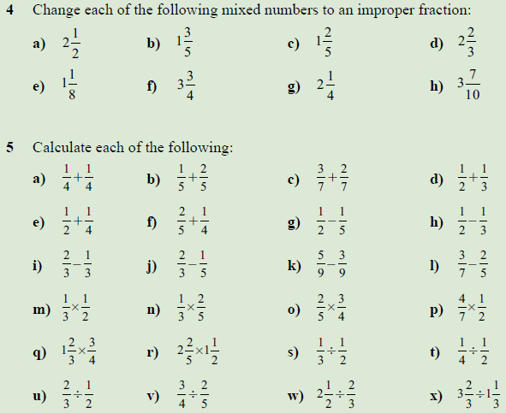
Remember – you are allowed a page of notes (back and front)

